Slide 1
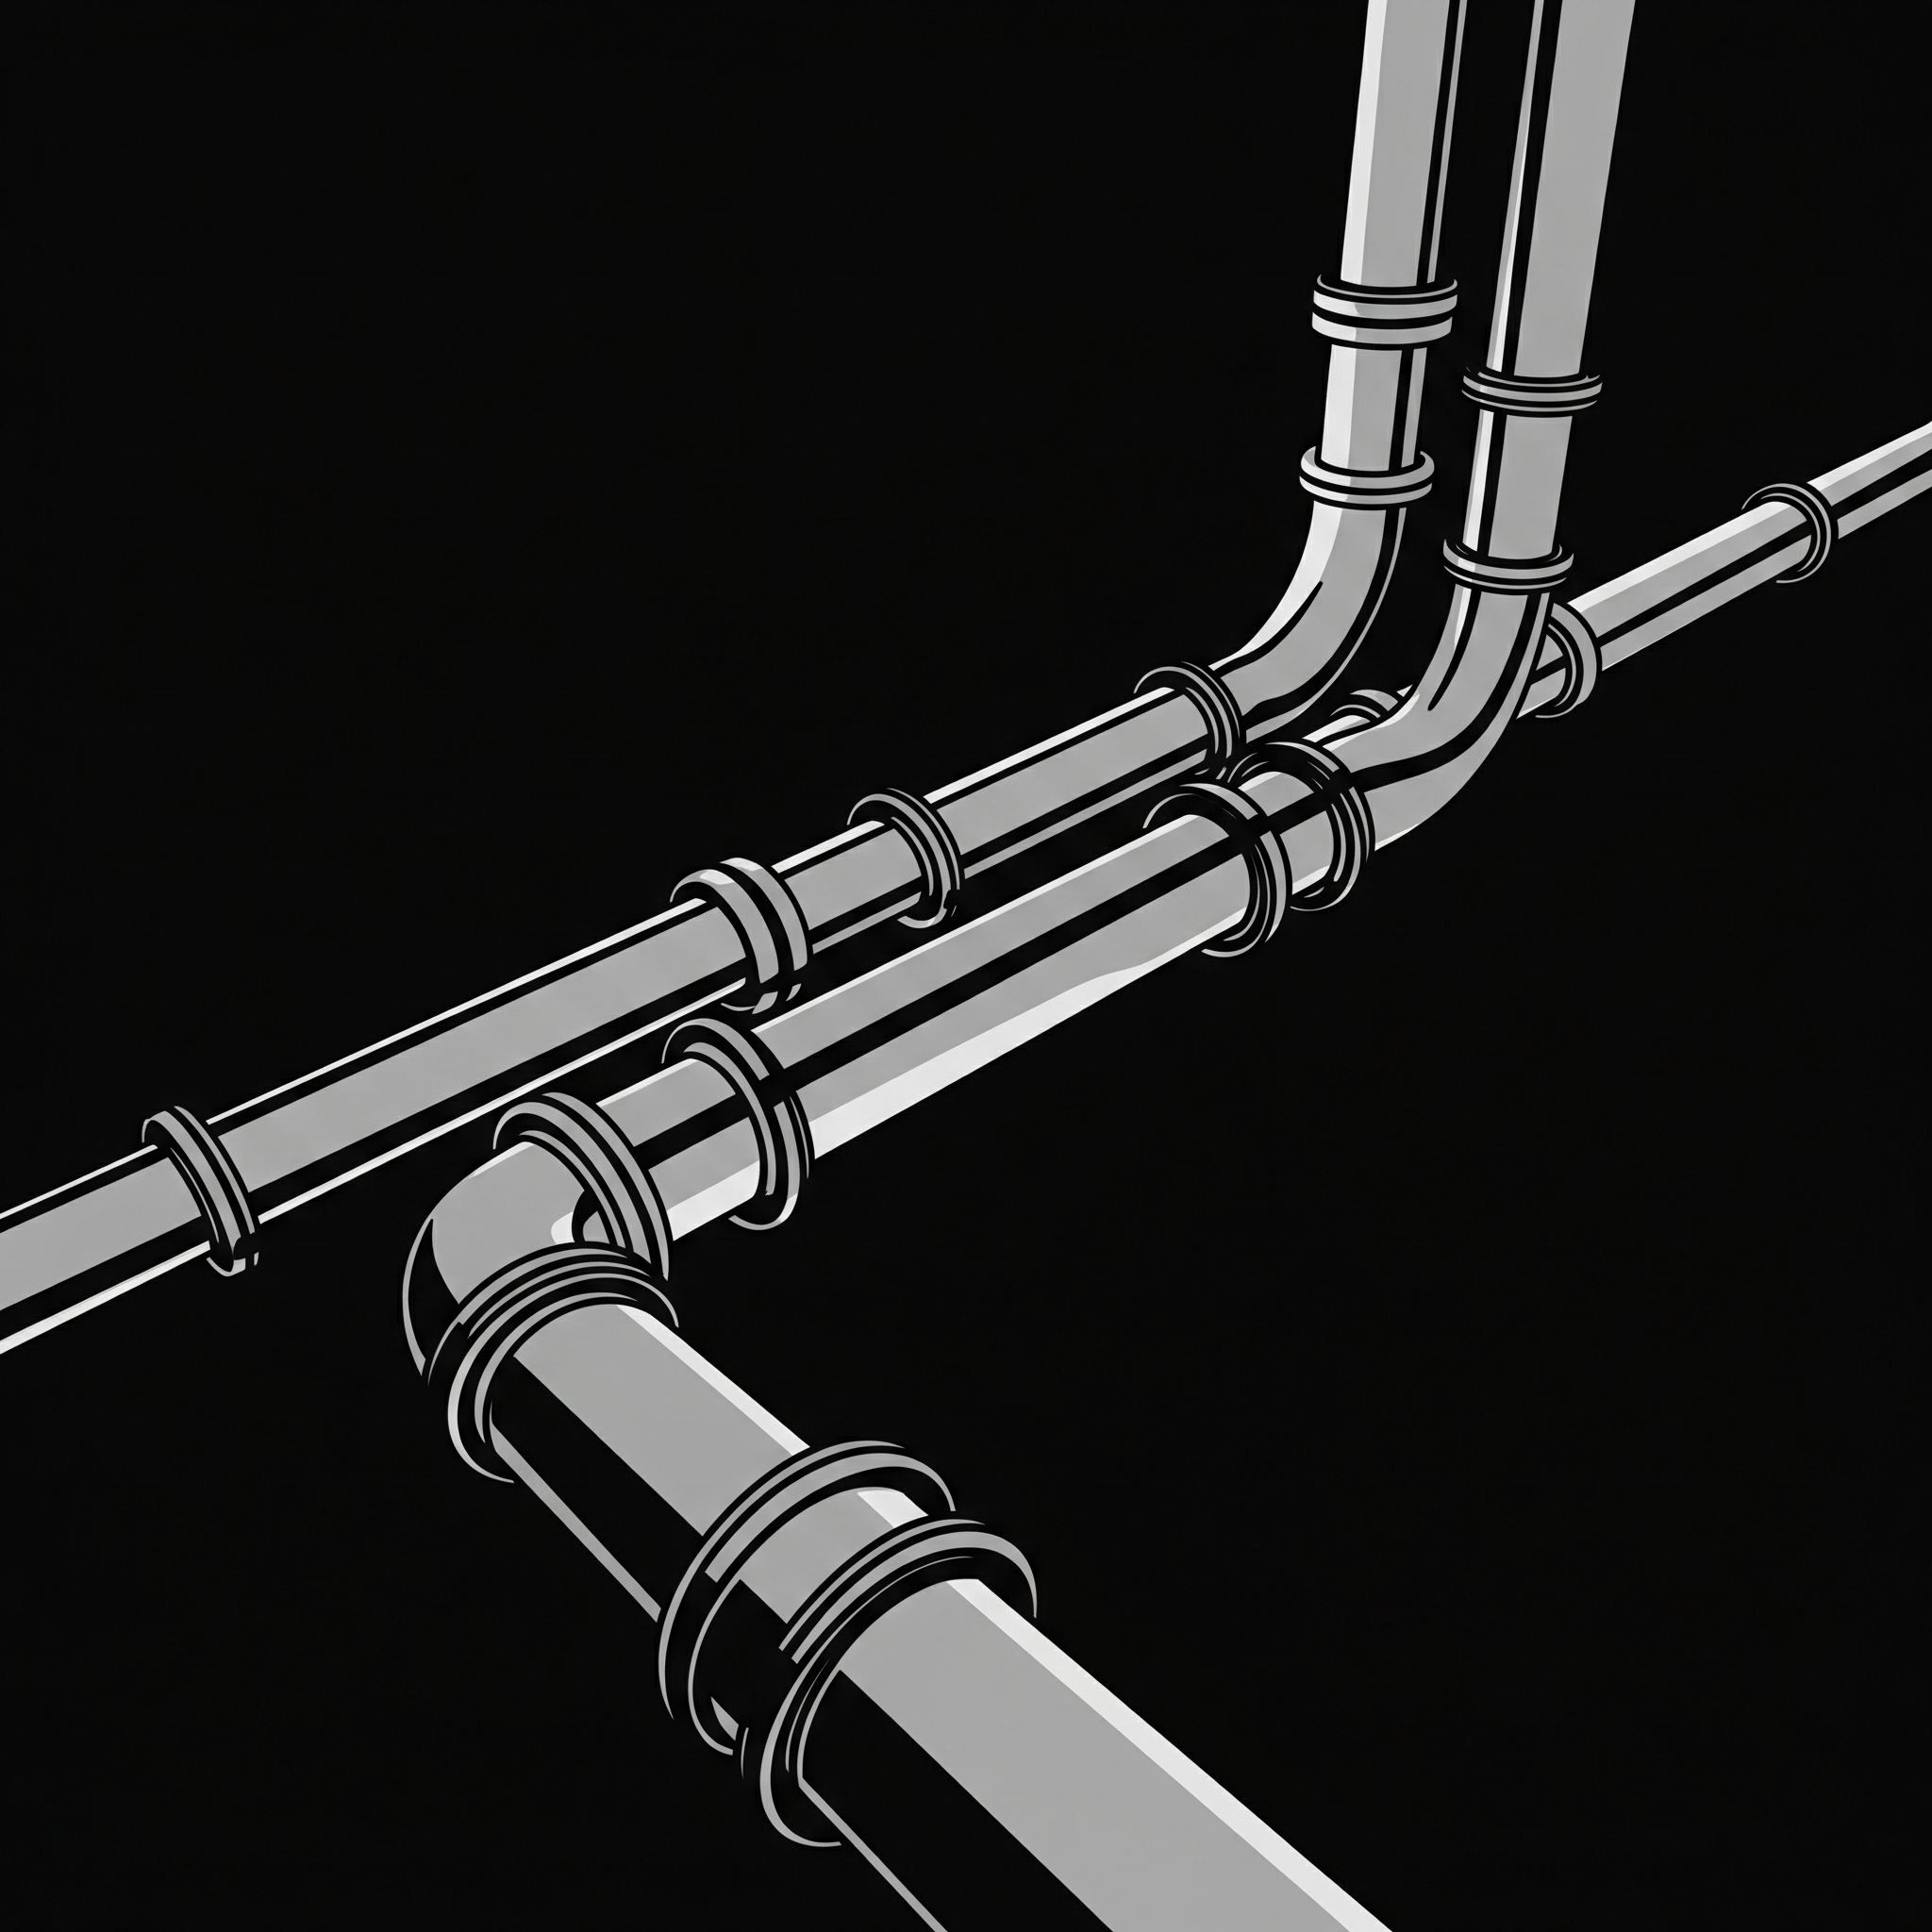
Optimized RAG Pipeline for Mortgage Document Analysis
Rob Lein
Extern
July 2025

Slide 2
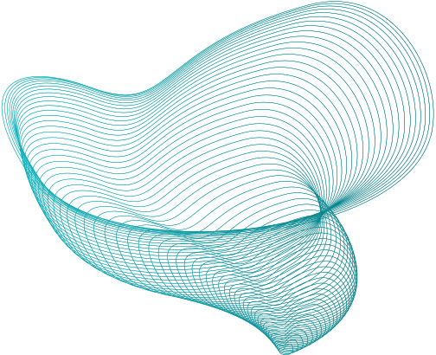

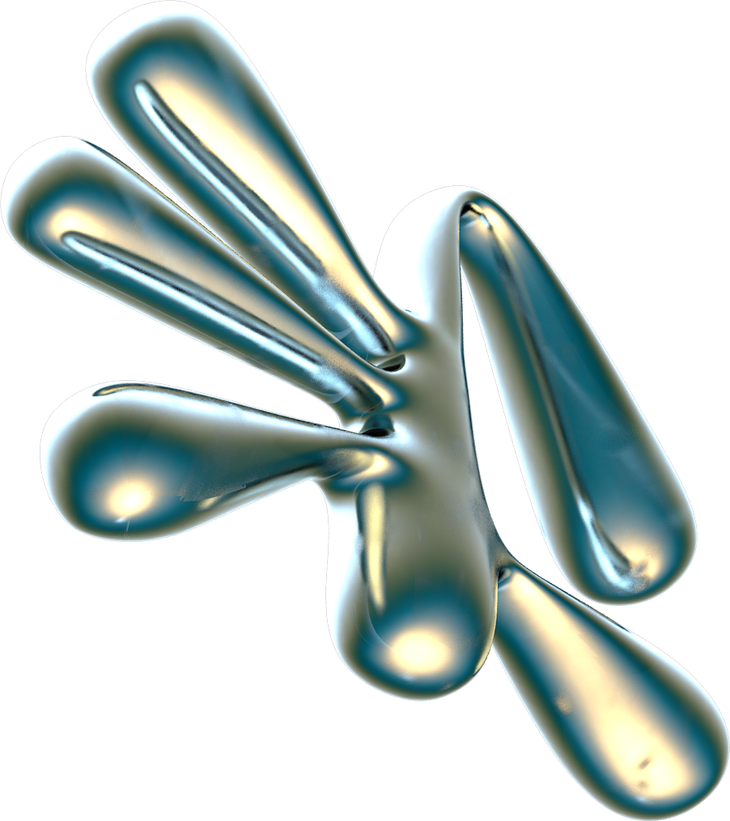
Solution Architecture
The Problem
The Solution
Mortgage documents arrive as lengthy, undifferentiated "blob files". Manual information extraction is costly, time-consuming, and prone to error.
My RAG pipeline enables rapid, accurate querying of mortgage documents using natural language. It bridges the gap between static documents and interactive knowledge retrieval, ensuring privacy by operating locally.
Notes:
"Let's start with the 'why'. The core problem we tackled is the immense inefficiency in the mortgage industry. Documents often come as hundreds of pages in unstructured 'blob files'. Manually extracting information from these is incredibly resource-intensive, slow, and unfortunately, prone to human error."
"My solution is an intelligent RAG pipeline. It allows users to upload PDFs and images, scan them with OCR, and then query the content using natural language. This system bridges the gap between static documents and interactive knowledge retrieval. Crucially, it processes documents locally, eliminating data privacy concerns often associated with cloud services, making it ideal for sensitive financial data."

Slide 3


Pipeline Architecture:
How It Works
Notes:
"This diagram visually represents the architecture of my RAG pipeline, following a classic pattern with local components. Let's walk through it."

Slide 4

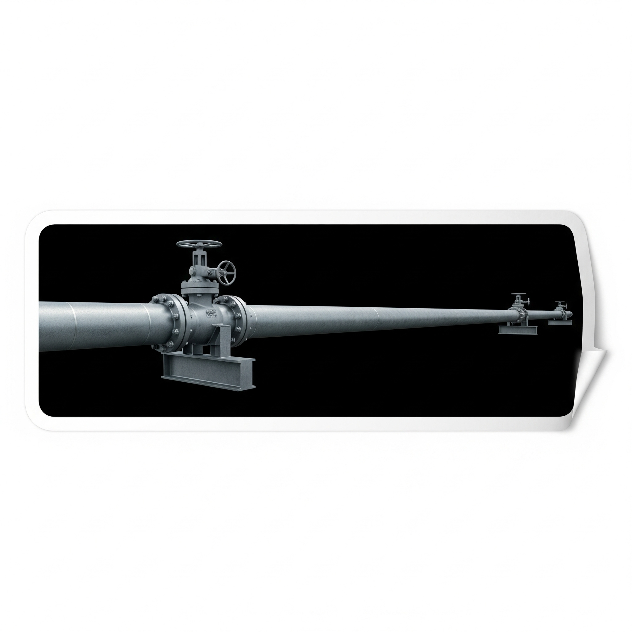

1.
2.
3.
4.
5.
Document Processing Layer
Indexing Layer
Retrieval Layer
Generation Layer
PresentationLayer
Llama Index for Vector Embedding of chunks into a vector database
User Query -> Query Embedding -> Vector DB Similarity Search -> Query Reranking -> Position-Based Grouping of Top Chunks
Retrieved Chunks -> Local LLM (TinyLlama)
Gradio Chat Interface for response & source citations
PyMuPDF for text extraction;
Section-Based Chunking (180 tokens/chunk, respects discontinuities)
Notes:
"It starts with the Document Processing Layer. Here, I use PyMuPDF to extract text from PDFs and images. This text is then intelligently broken down using section-based chunking, ensuring meaningful segments are created, each limited to 180 tokens, which was key for context preservation."
"Next, the Indexing Layer takes these chunks and uses Llama Index to create vector embeddings – essentially, numerical representations that capture the meaning of the text. These are stored in a vector database."
"When a user enters a query, the Retrieval Layer springs into action. The query is embedded, and a similarity search identifies the most relevant chunks. I then apply query reranking to prioritize the most pertinent information, and crucially, I group the retrieved chunks by their original document position to maintain coherence for the LLM."
"These refined chunks are then passed to the Generation Layer, where our local LLM, TinyLlama, synthesizes the answer. The final response is delivered via the Gradio Chat Interface in the Presentation Layer, complete with source citations for transparency.

Slide 5
Experiments & Optimizations:
The Development Journey
Notes:
"This diagram visually represents the architecture of my RAG pipeline, following a classic pattern with local components. Let's walk through it."

Slide 6
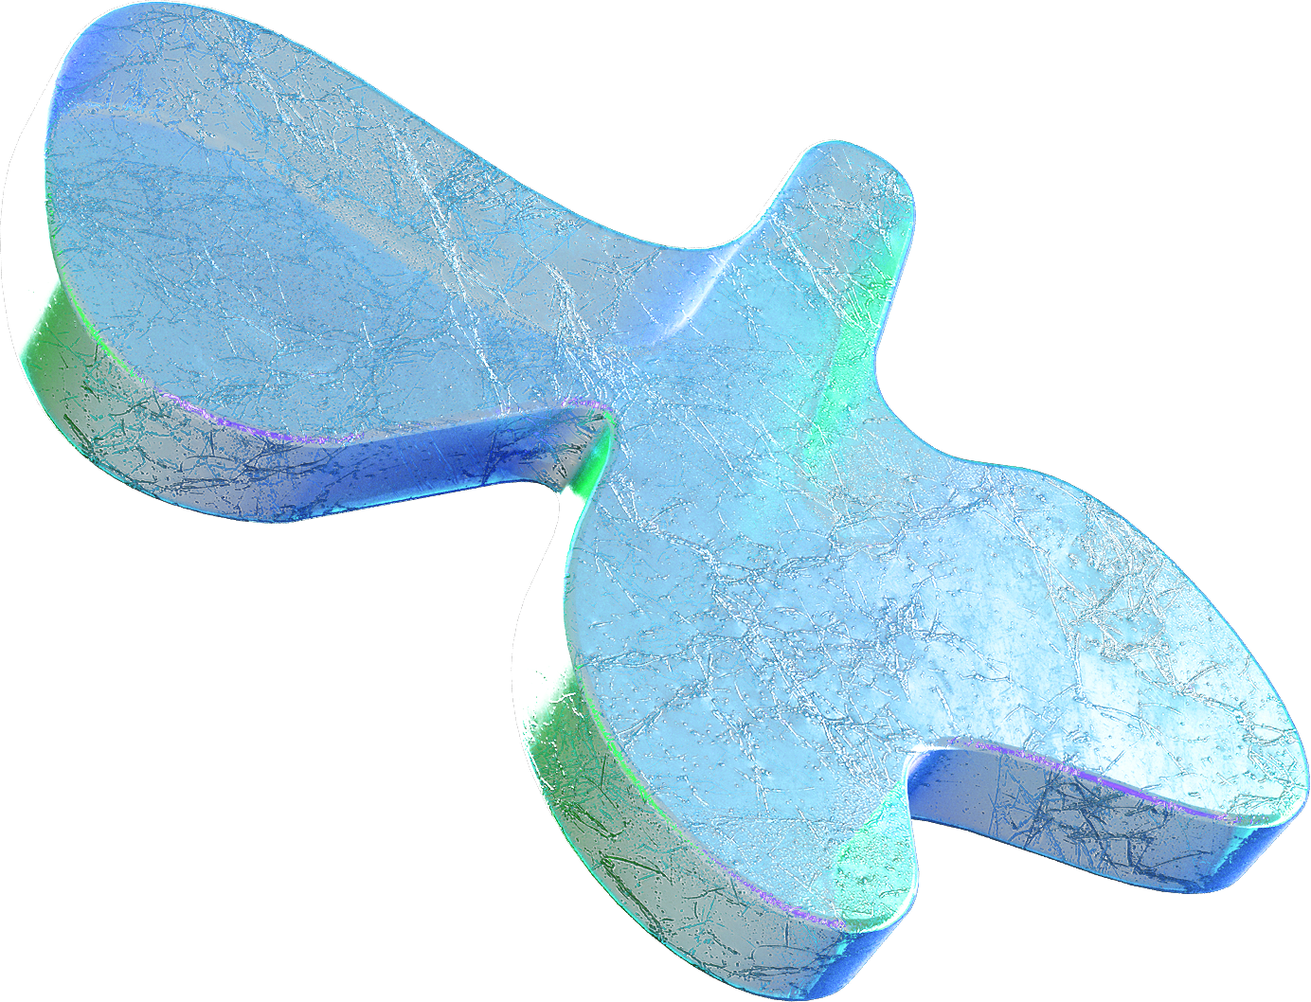

GPU
Offloading
Chunk Size & Context Window
Increased GPU layers (from 4 to 20) significantly reduced LLM response times
Smaller, section-based chunks with specific token limits improved response accuracy
Query Reranking & Positional Grouping
Gradio
Interface
Enhanced retrieval precision and context flow
Made creating an interactive, local demo incredibly straightforward
Notes:
"Our development journey, like any good project, was iterative and full of learning. We faced several key challenges upfront. Initially, my chunking strategy was suboptimal; I learned quickly that simply throwing large chunks, sometimes entire pages, at the LLM often led to irrelevant or far too verbose answers."
"Debugging and adapting Python code to enhance responses was a delicate dance; subtle changes could introduce unexpected errors, demanding meticulous debugging and rewriting. Integrating and optimizing open-source models, like TinyLlama, came with its own set of hurdles. It often involved deep dives into documentation, troubleshooting across various online tutorials, and adapting to model updates that might not be reflected in older resources. It definitely expanded my Python skills."
"These challenges led to crucial optimizations. One significant breakthrough was configuring llama_cpp for GPU offloading. By increasing GPU layers from 4 to 20, we saw an 84% decrease in response times from the LLM. This was a game-changer for practical performance."
"We also confirmed that our section-based chunking strategy with specific token limits significantly improved response accuracy, and that combining query reranking with positional grouping of retrieved chunks greatly enhanced retrieval precision and the logical flow of information."

Slide 7
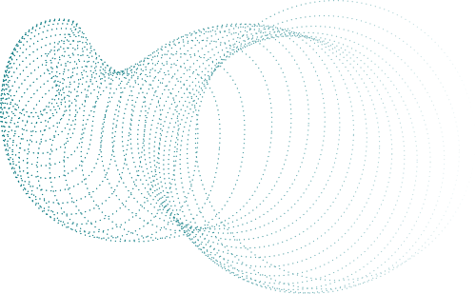
What Worked Well:
What Posed Challenges:
Performance & Insights:
Sentence Transformers (BAAI) for high-quality embeddings.
TinyLlama via llama_cpp for efficient, quantized LLM inference on GPU.
Section-based chunking & query reranking for context preservation.
Gradio for intuitive, local chat interface
Complex integration of certain LlamaIndex components.
Persistent environmental/
compatibility issues (e.g., device_map errors)
Core Trade-off: Accuracy vs. Processing Time. Faster responses sometimes less accurate; high accuracy required more computation
Critical Realization: Data Security paramount, especially for financial documents. Local processing addresses this
What Worked & What Didn't
Notes:
"Here's a snapshot of our performance insights. On the 'what worked' side, Sentence Transformers from HuggingFace proved excellent for generating high-quality embeddings, which is the backbone of effective retrieval. TinyLlama via llama_cpp provided surprisingly efficient LLM inference directly on the GPU for a quantized model."
"Our section-based chunking and query reranking strategies were undeniably successful in preserving context and improving retrieval precision. And the Gradio interface made creating an interactive, local demo incredibly straightforward."
"However, we also identified areas that posed challenges. Certain integrations with LlamaIndex components were complex, and we battled persistent environmental compatibility issues. Most critically, we observed a clear trade-off between accuracy and processing time. Achieving higher accuracy generally required more computational resources, leading to slightly longer response times."
"Perhaps the most important business lesson was the realization that data security is paramount, especially when dealing with sensitive financial documents. Our local processing approach inherently addresses this, reinforcing its value for Outamation."

Slide 8

Final Takeaways & Next Steps

Slide 9

Building RAG
Good document structure
Understanding underlying library behaviors
Local LLMs
is an iterative process requiring patience, testing, and adaptation
offer excellent performance while ensuring data privacy
and sophisticated chunking are vital for retrieval quality
(e.g., GPU layers) is crucial for optimization
Key Takeaways

Slide 10



Implement Hierarchical Chunking for complex documents.
Future Vision
Expand to Multi-Document Handling & Classification.
Enhance Section Detection (header recognition).
Improve Advanced Document Parsing
Notes:
"To summarize my key learnings from this project: Building a RAG pipeline is an iterative journey of continuous drafting, testing, and adaptation. It demands patience and persistence, much like any complex design process."
"I learned that deeply understanding how underlying libraries like llama_cpp handle parameters, such as GPU layers, is absolutely critical for performance optimization."
"A significant insight is that local LLMs like TinyLlama can deliver excellent results while simultaneously providing robust data privacy, a non-negotiable for sensitive data. And fundamentally, good document structure combined with sophisticated chunking is paramount for the quality of information retrieval."
"Looking forward, my vision for this pipeline includes: implementing hierarchical chunking for even more precise context in complex documents; enhancing section detection with smarter header recognition; and a major step will be expanding to multi-document handling with classification, allowing users to query entire knowledge bases."
"I also plan to incorporate direct source verification in the UI for greater trust and ease of auditing, and to improve advanced document parsing to handle tables and figures, not just text."

Slide 11
Thank You for Your Attention!
for the presentation template
Notes:
"Thank you all for your time and attention today. I'm excited about the potential of this RAG pipeline to transform document analysis. I'm now happy to take any questions."

